Slide 1

Airbnb Price Prediction
Noa Gao, Junrui Wan, Maggie Wu, Pujing Yang, Kaiwen Zhang, Curtis Zhuang
March 17th, 2021
Notes:
Team 5, we are going to

Slide 2

Agenda
Business Overview
Data Overview (EDA)
Data Preparation
Model and Result
Key Findings
Challenges and Next Steps

Slide 3

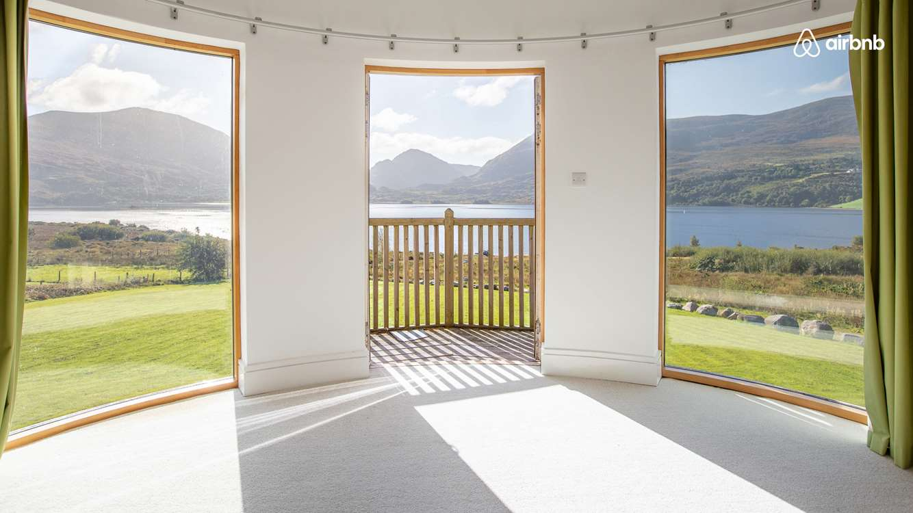



Business Overview
Data Overview
Data Preparation
Model and Result
Key Findings
Challenges and Next Steps
Problem Statement
The date we gather is coming from Airbnb. It is an American vacation rental online marketplace. We expect to find the relationship between prices, house descriptions, customer reviews, and the features like property types, amenities, locations
In this case, learning the customers' preferences enables the hosts to decide where they should improve, for example, whether they should change the bed type or upgrade the amenities in order to get higher customer ratings. This also allows the hosts to set a competitive price for their property
In addition, price forecasting also allows the consumers to quickly compare the different rooms, find the room they like and stay them at a fair price
This Photo by Unknown author is licensed under CC BY-NC-ND.
Notes:
Lets start with problem statement:
Next, we are moving on to data overview with kevin

Slide 4

Data Overview
Raw dataset
Data limitations
Correlation matrix heatmap
Raw data visualizations

Slide 5

Data Overview
Business Overview
Data Overview
Data Preparation
Model and Result
Key Findings
Challenges and Next Steps
Feature Name
id
accommodates
cleaning_fee
host_has_profile_pic
Instant_bookable
name
Thumbnail_url
property_type
bathrooms
city
host_identity_verified
Last_review
neighbourhood
zipcode
Feature Name
room_type
bed_type
description
host_response_rate
Latitude
Number_of_reviews
bedrooms
amenities
cancellation_policy
first_review
Host_since
longitude
Review_scores_rating
beds
Raw dataset:
56389 rows
29 columns
Target variable : log_price
28 features
Source:
Notes:
Source: https://www.kaggle.com/stevezhenghp/airbnb-price-prediction

Slide 6



Data Overview: Limitations
Business Overview
Data Overview
Data Preparation
Model and Result
Key Findings
Challenges and Next Steps
MISSING VALUES
SUBJECTIVE DATA:
DESCRIPTION

Slide 7
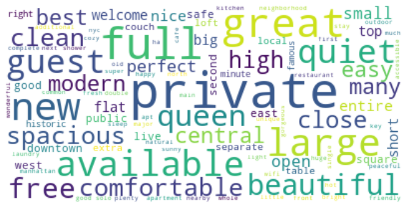
Data Overview: Limitations
Business Overview
Data Overview
Data Preparation
Model and Result
Key Findings
Challenges and Next Steps
VARIABLE | % | VARIABLE | %
bathrooms | 0.28% | last_review | 0.002%
first_review | 0.002% | neighbourhood | 8.80%
host_has_profile_pic | 0.25% | thumbnail_url | 10.1%
host_identity_verified | 0.25% | zipcode | 1.17%
host_response_rate | 16.3% | bedrooms | 0.12%
host_since | 0.25% | beds | 0.11%
12 out of 29 columns have missing values
“Beautiful, sunlit brownstone 1-bedroom in the loveliest neighborhood in Brooklyn…”
“Cool, cozy, and comfortable studio located in the heart of the city…”
“Beautiful private room overlooking scenic views in San Francisco's upscale Noe Valley neighborhood…”

Slide 8
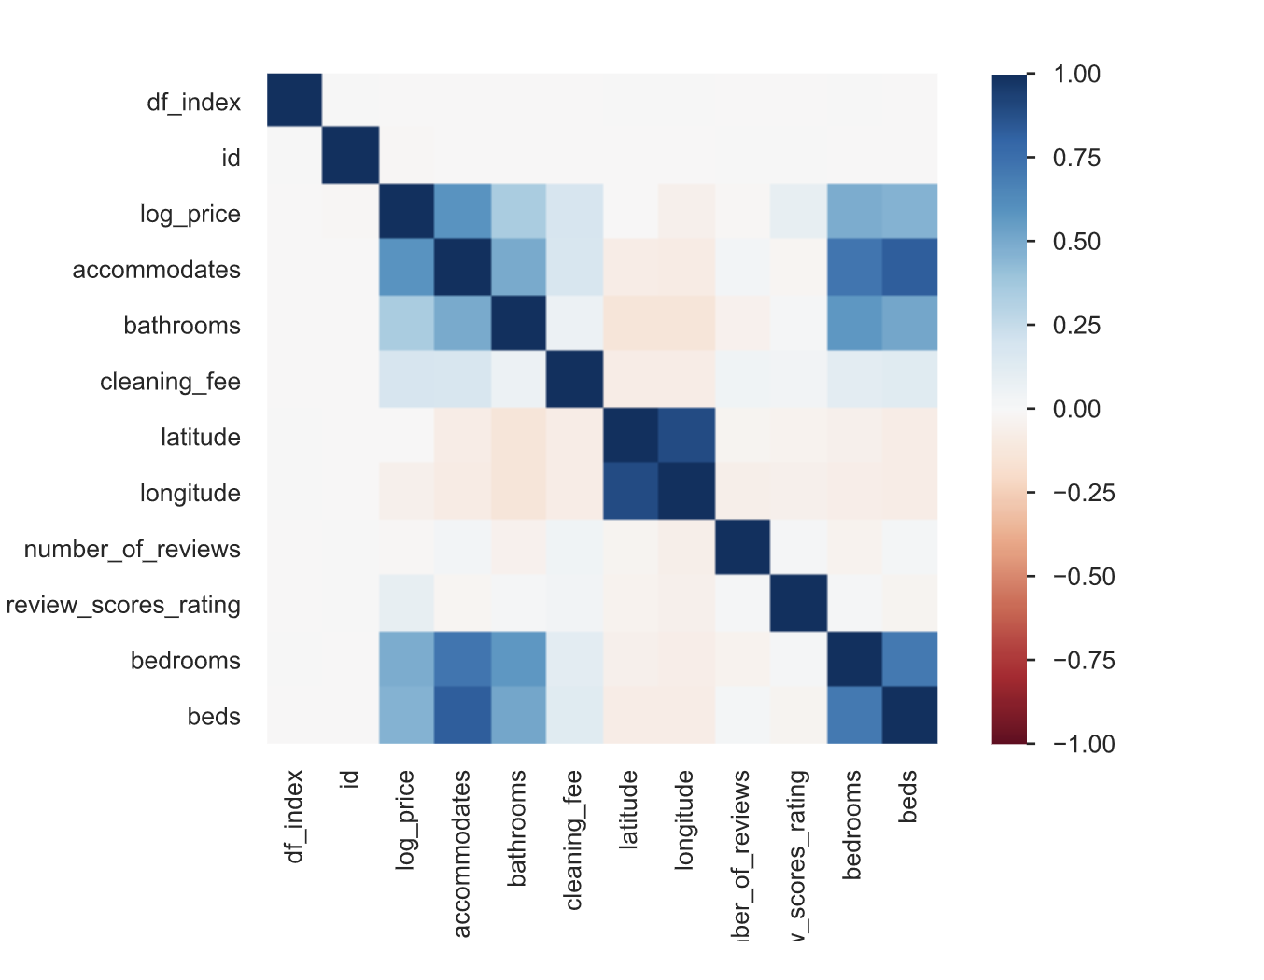
Data Overview: Correlation Matrix Heatmap
Business Overview
Data Overview
Data Preparation
Model and Result
Key Findings
Challenges and Next Steps
Beds, bedrooms, accommodates, and bathrooms are highly correlated

Slide 9
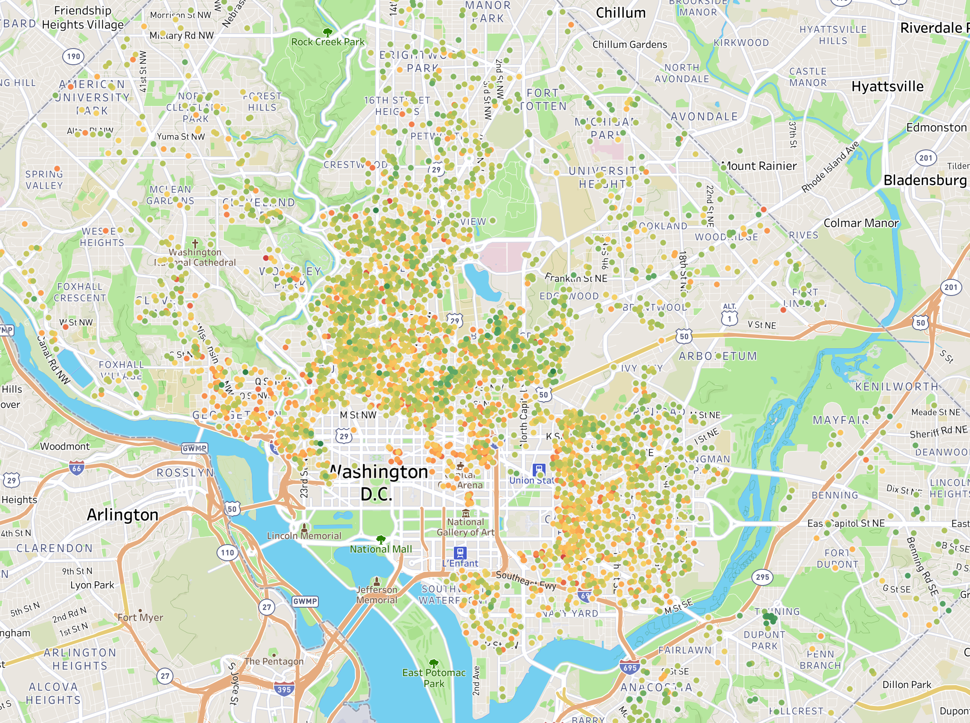
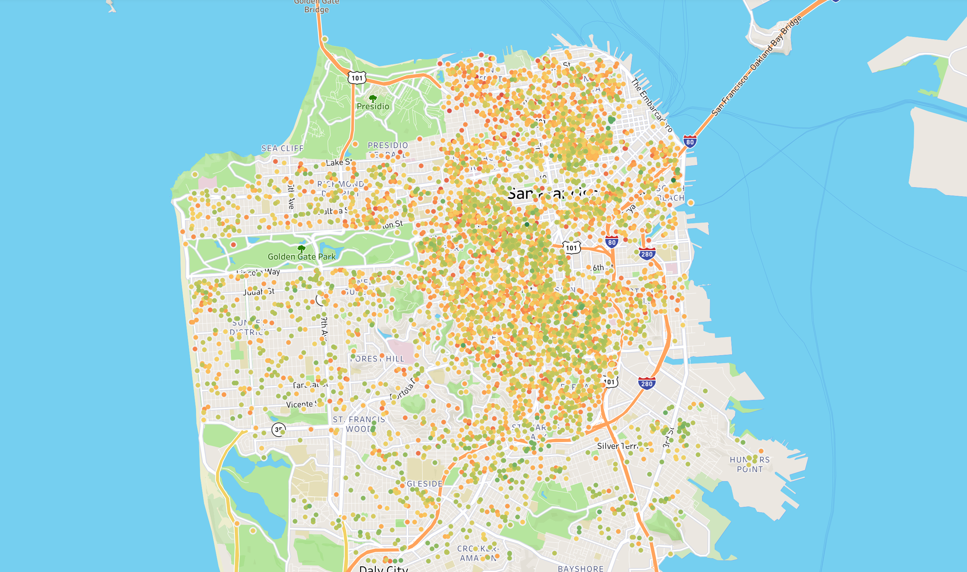
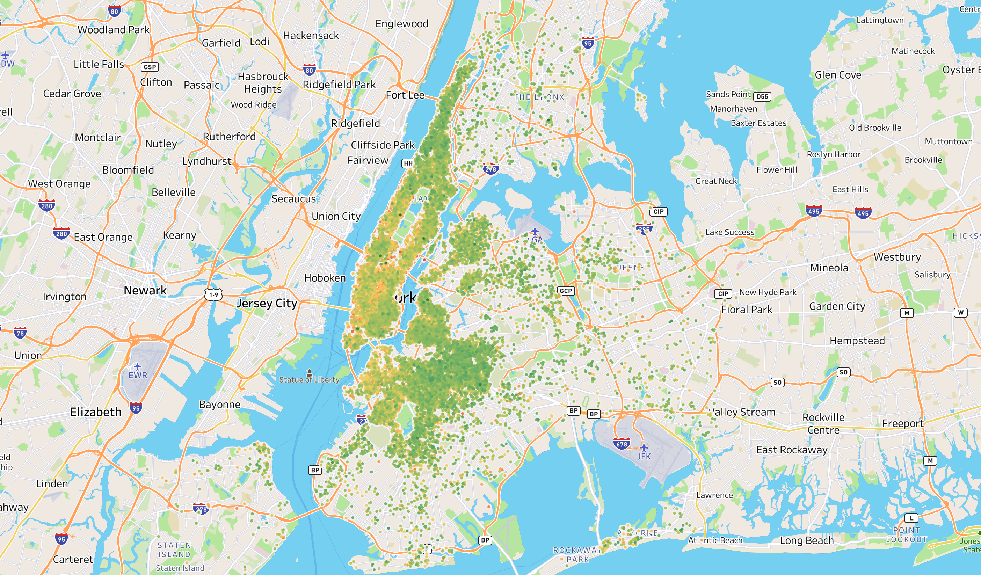
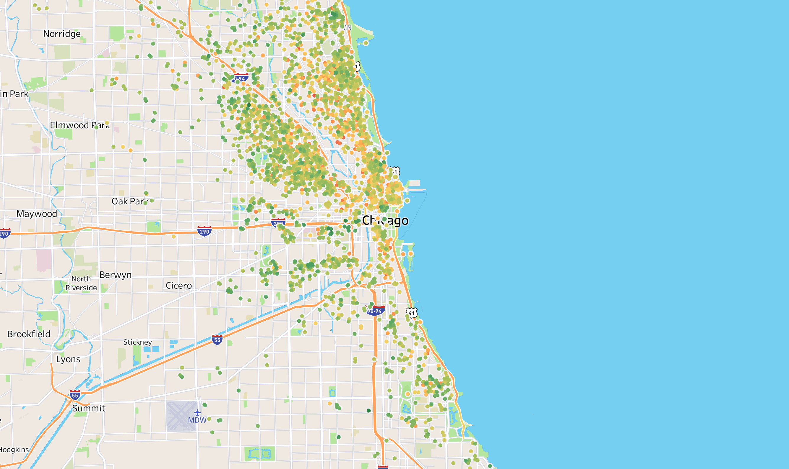
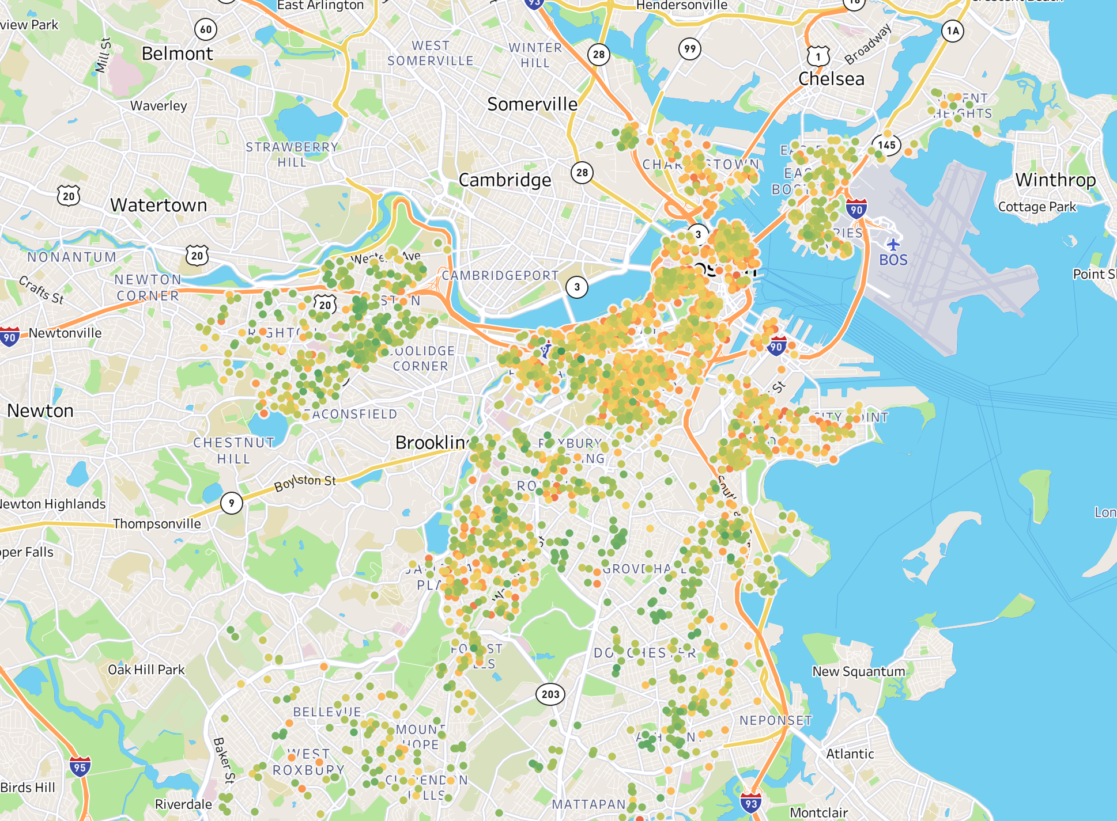
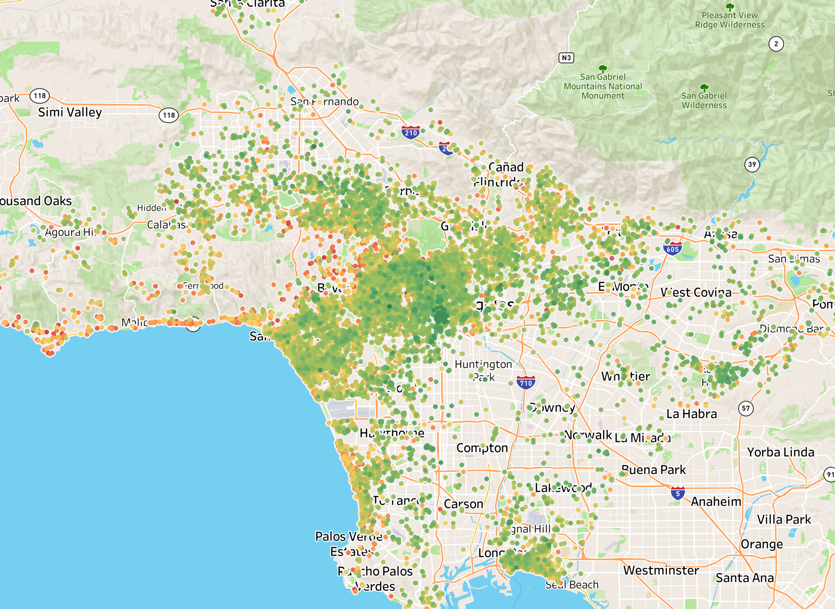
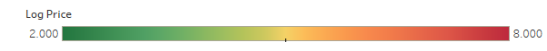
Business Overview
Data Overview
Data Preparation
Model and Result
Key Findings
Challenges and Next Steps
Washington DC
Avg. log price: 4.80
Count: 4,100
San Francisco
Avg. log price: 5.11
Count: 5,047
New York City
Avg. log price: 4.71
Count: 25,028
Chicago
Avg. log price: 4.59
Count: 3,208
Boston
Avg. log price: 4.86
Count: 2,820
Los Angeles
Avg. log price: 4.70
Count: 17,186

Slide 10
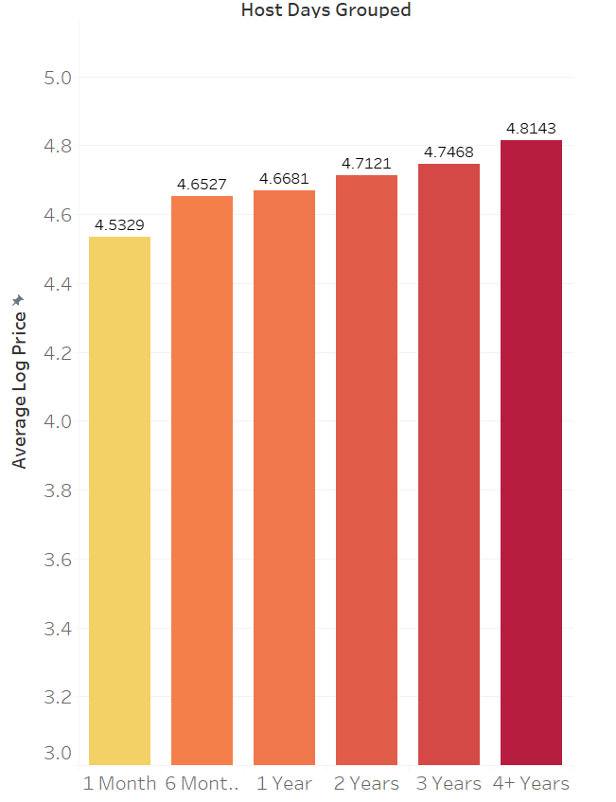
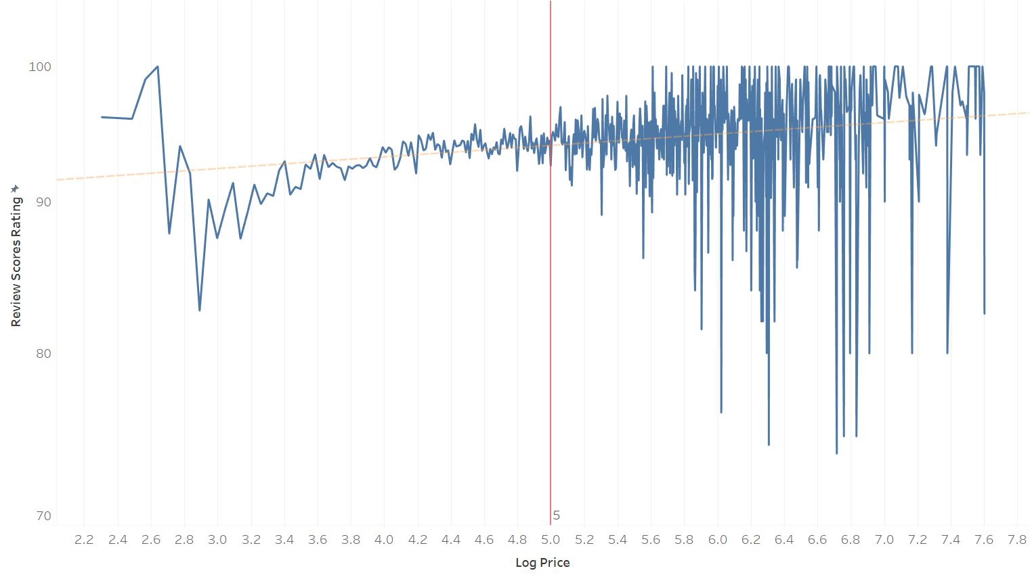
Business Overview
Data Overview
Data Preparation
Model and Result
Key Findings
Challenges and Next Steps
Review Score Rating vs Log Price
Avg. Price vs Host Days
Generally, average price increased with host days
For log price above 5.0, review score ratings have significant fluctuations

Slide 11
Data Preparation
Data Cleaning
Text Mining
Feature Engineering
Visualization

Slide 12
Data Preparation
Business Overview
Data Overview
Data Preparation
Model and Result
Key Findings
Challenges and Next Steps
28 variables
id | property_type | room_type | amenities
accommodates | bathrooms | bed_type | cancellation_policy
cleaning_fee | city | description | first_review
host_has_profile_pic | host_identity_verified | host_response_rate | host_since
instant_bookable | last_review | latitude | longitude
name | neighbourhood | number_of_reviews | review_scores_rating
thumbnail_url | zipcode | bedrooms | beds
Notes:
unmodified dataset

Slide 13






Data Preparation
Business Overview
Data Overview
Data Preparation
Model and Result
Key Findings
Challenges and Next Steps
Method
Example
Variables: 28
Drop unnecessary columns
id
Variables: 17
Fill missing values
review_scores_rating
Variables: 17
Drop duplicates
No duplicates
Variables: 17
Remove outliers
host_days
Variables: 27
Create dummies
property_type
Variables: 25
Create new features
bath_per_bedrooms
Notes:
Go through some methods in EDA/feature engineering
1: drop unnecessary features. eg: id (100% distinct values)
2: find missing values : consider droping or interpolating eg: review_Score_rating has too many missing values, drop rows > interpolate
3: drop duplicates: no duplicates
4: remove outliers: eg:host_days, we find there are some outliers and drop them
5. categorical features -> create dummy variables eg: property_type -> 3 dummies (apartment,house,other)
6: correlation among a few features such as beds, bedrooms. --> create new features to reduce correaltion

Slide 14
Data Preparation- Feature Engineering
Business Overview
Data Overview
Data Preparation
Model and Result
Key Findings
Challenges and Next Steps
25 variables
amenities | description | host_identity_verified | host_response_rate
number_of_reviews | review_scores_rating
is_apt | is_house | is_other_ppt_type | is_entireRoom
is_privateRoom | is_sharedRoom | is_cancellation_policy | is_cleaning_fee
is_instantBookable | is_city_nyc | is_city_la | is_city_sf
is_city_dc | is_city_chicago
host_days | bath_per_bedrooms | beds_per_person
Notes:
The final version of our dataset
Black: original features left (after EDA, drop uselss features)
Blue: dummy variables (feature engineering : step1 create dummy)
Red: new feature created (feature enginering: step3 create new features and reduce correlation)

Slide 15
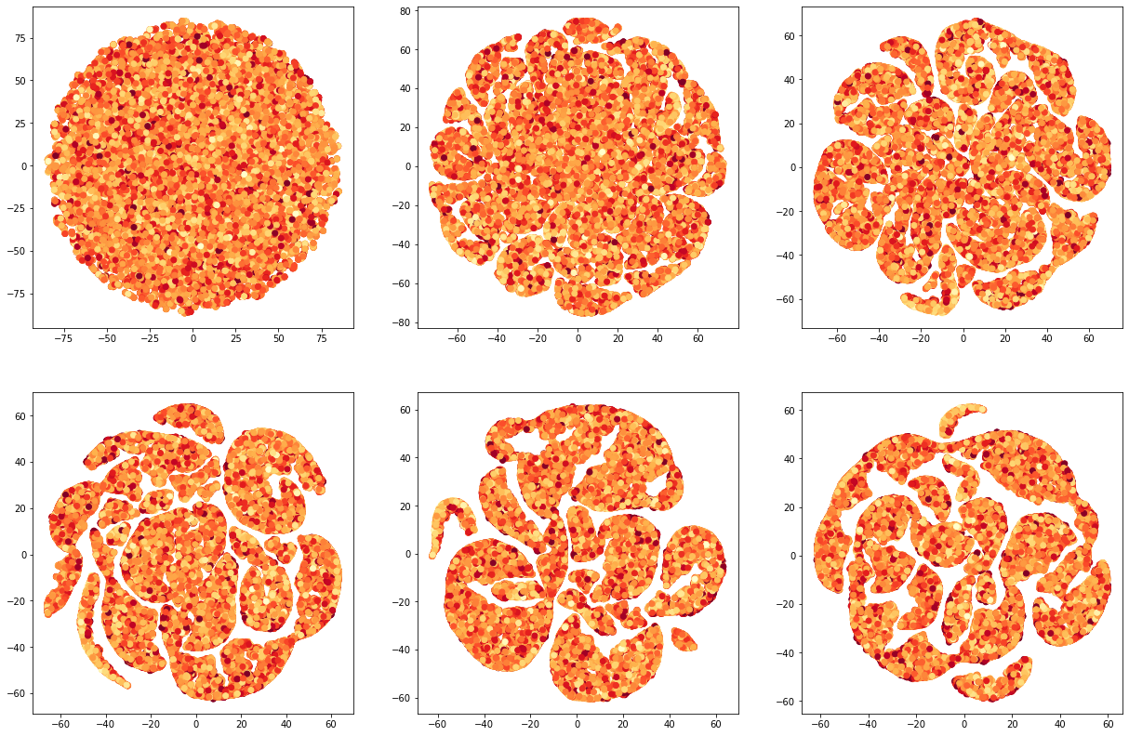

Business Overview
Data Overview
Data Preparation
Model and Result
Key Findings
Challenges and Next Steps
TSNE
Perplexity tuning
5, 20, 40
60, 80, 100
Notes:
Perplexity is a tuneable parameter (a guess about the number of close neighbors each point has.)
So large dataset usually has larger perplexity
Here, we basically observe the resulting pictures of our dataset by changing perplexity
Perplexity : 5,20,40,60,80,100
Color: red ---> yellow high price ---> low price

Slide 16
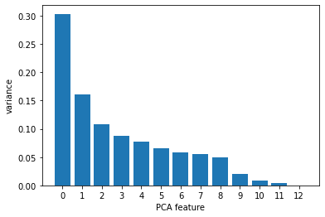
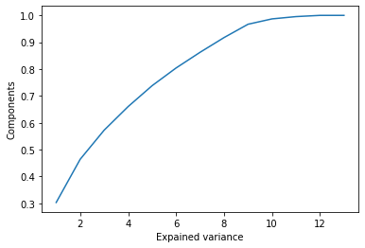
PCA
Business Overview
Data Overview
Data Preparation
Model and Result
Key Findings
Challenges and Next Steps
Notes:
Dimension reduction
Use high variance pca features, drop low variance pca features

Slide 17
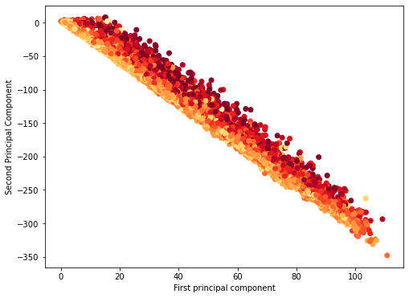
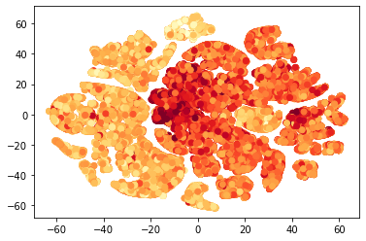
Business Overview
Data Overview
Data Preparation
Model and Result
Key Findings
Challenges and Next Steps
PC1 vs. PC2
TSNE using PCA (n_comp=8)
Notes:
Graph 1: scatterplot pc1 vs pc2, there are some clusters shown ( low price below the high price)
Graph2: TSNE using pca(n_components =8), see clusters , same price are likely to be clustered together

Slide 18
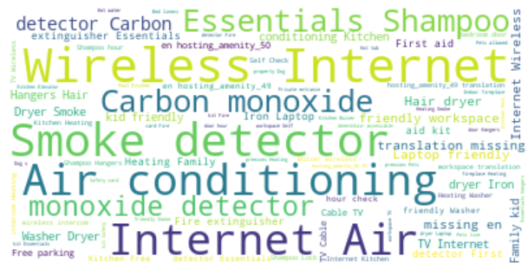

Text Mining: Amenities
Business Overview
Data Overview
Data Preparation
Model and Result
Key Findings
Challenges and Next Steps
pets_allowed
gym_pool
garden_patio
elevator
Breakfast
Hangers
fireplace
free_parking
air_conditioning
baby_friendly
household_appliances
bathroom_essentials
bedroom_essentials
kitchen_essentials
good_security_system
good_working_environment
wheelchair_accessible
Create 17 categories for 100+ amenities

Slide 19

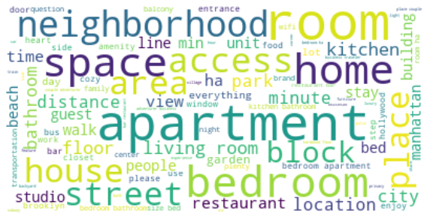

Text Mining: description
Business Overview
Data Overview
Data Preparation
Model and Result
Key Findings
Challenges and Next Steps
Word Cloud
Description 1:
Beautiful private room overlooking scenic views in San Francisco's upscale Noe Valley neighborhood. You'll have your own bedroom, queen bed, dresser, wardrobe, smart TV, workstation, desk&chair, WiFi, and kitchen. Fresh towels and linens are provided for your convenience. Restaurants, bars, and cafes are around the corner. Ideal location for experiencing SF or commuting to Silicon Valley. We'll provide 100% cotton sheets and fresh towels. Guests will have access to kitchen and bathroom in addition to their private bedroom. We'll interact with you as much as you'd like to make your stay as comfortable as possible. One of the sunniest neighborhoods in SF…
Description 2:
Enjoy travelling during your stay in Manhattan. My place is centrally located near Times Square and Central Park with easy access to main subways as well as walking distance to many popular restaurants and bus tours. My place is close to the subway, Totto Ramen, ….
Nouns
Adjectives
Notes:
Enjoy travelling during your stay in Manhattan. My place is centrally located near Times Square and Central Park with easy access to main subways as well as walking distance to many popular restaurants and bus tours. My place is close to the subway, Totto Ramen, Hell's Kitchen, Ippudo Westside, Empanada Mama, Intrepid Sea, Air & Space Museum. My place has three true bedrooms and one bathroom. The kitchen is stocked with stainless steel appliances like the Keurig machine. The living room is spacious and can accommodate another person thanks to the pull out bed. My place is centrally located to some of the top attractions in the city. Feel free to explore the entire apartment and do not worry about sharing the space with any strangers. This is all yours during your stay. I am available via text/email/phone for anything you might need. - Times Square - Rockefeller Plaza - Central Park - 5th Avenue Shopping -Broadway Theater District - Empire State Building - Hudson River Express Subwa 2 The Oasis comes complete with a full backyard with outdoor furniture to make the most of this summer vacation!! The unit has high ceilings, a completed renovation throughout, beautiful flood lighting and exposed brick! Best part, total seclusion. You share with no one! The entire unit is yours during your stay. It's a fully furnished apartment that can hold up to 5 people. The only items you need are a toothbrush and your luggage!!! The unit has high ceilings, a completed renovation throughout, beautiful flood lighting and exposed brick! Not to mention the large backyard complete with ourdoor furniture. Best part, total seclusion. You share with no one! The entire unit is yours during your stay. The entire unit and backyard Garden area My assistant is available off site via phone. Other than that, you will be alone for your stay. The neighborhood of central Harlem is very diverse and full of culture! We are a few blocks from Historic 125th Street, The Apollo Theatre, The Schomburg 3 Cool, cozy, and comfortable studio located in the heart of the city. Literally a 10 min walk to Columbia Heights metro where you'll find shopping, theater, bars and diverse restaurants. Fits two very well, and is very convenient to other great areas. Welcome home! It's in a diverse building, where you meet alot of international people. It's located around different embassies, whom may provide a tour. Theres tons of people from over the world! Tons of different restaurants, and cultural things to do. Less than a mile walk to Dupont Circle, U Street, Adams Morgan, Columbia Heights metro. Tons of buses, and underground metro at your fingertips I can provide groceries for an affordable fee 4 Beautiful private room overlooking scenic views in San Francisco's upscale Noe Valley neighborhood. You'll have your own bedroom, queen bed, dresser, wardrobe, smart TV, workstation, desk&chair, WiFi, and kitchen. Fresh towels and linens are provided for your convenience. MUNI bus stop and all tech shuttles are around the corner, J-Church subway is 5-minute walk away. Restaurants, bars, and cafes are around the corner. Ideal location for experiencing SF or commuting to Silicon Valley. We'll provide 100% cotton sheets and fresh towels. You'll have access to the full size bathroom as well as the kitchen. We'll also provide high speed business class WiFi internet, as well as HBO and Net"ix on your private TV. Guests will have access to kitchen and bathroom in addition to their private bedroom. We'll interact with you as much as you'd like to make your stay as comfortable as possible. We are available if you need us but will not disturb you otherwise. One of the sunniest neighborhoods in S

Slide 20
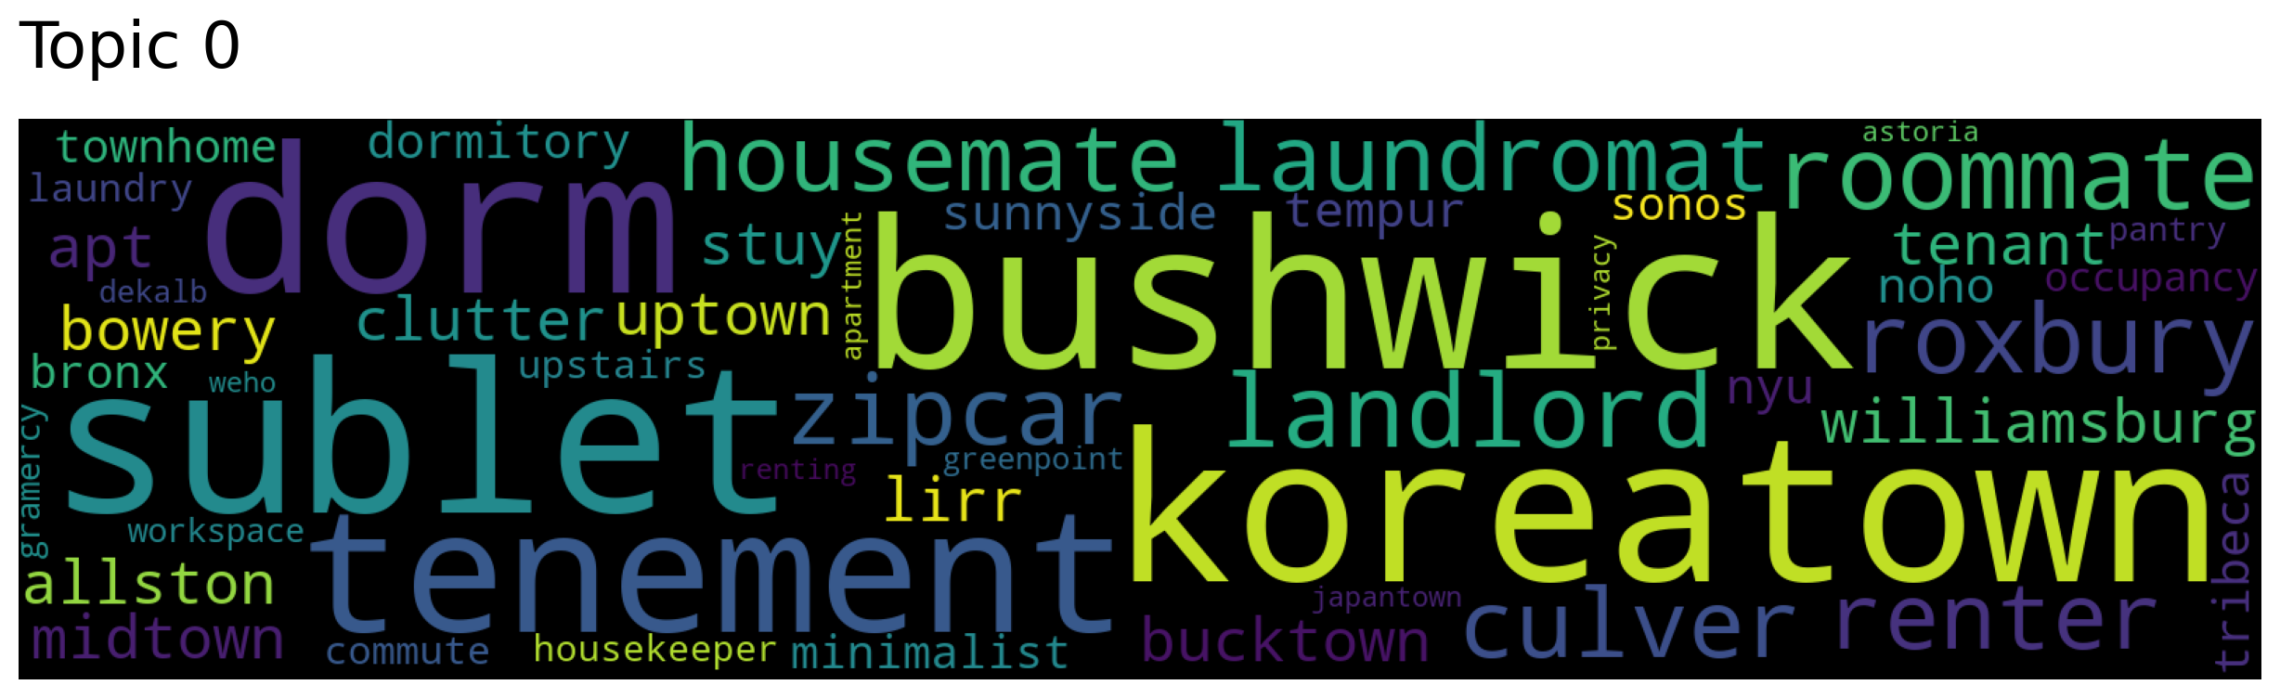
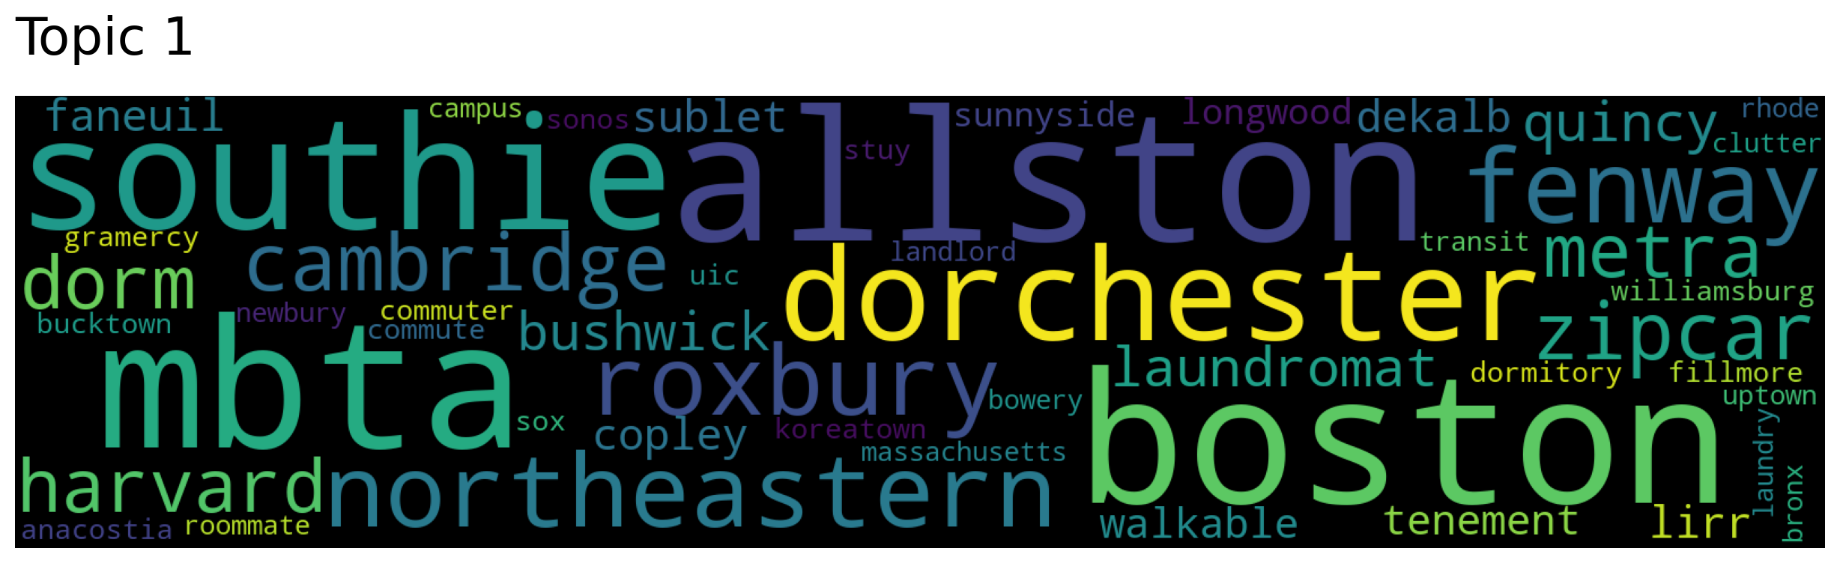
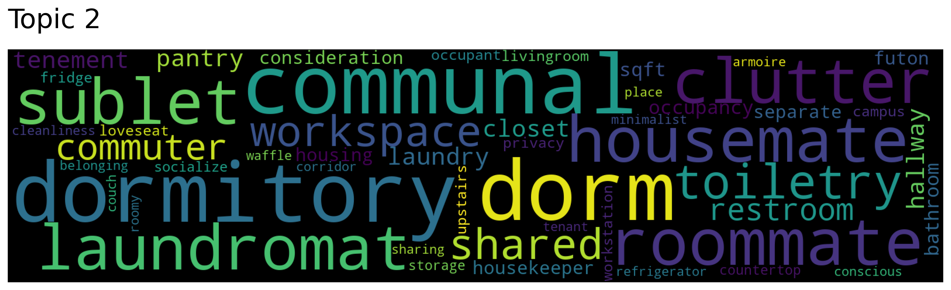
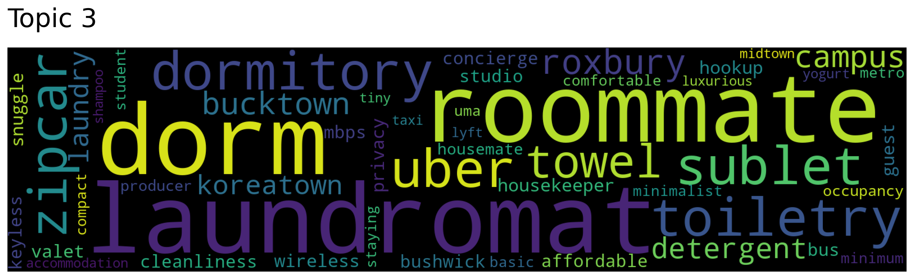
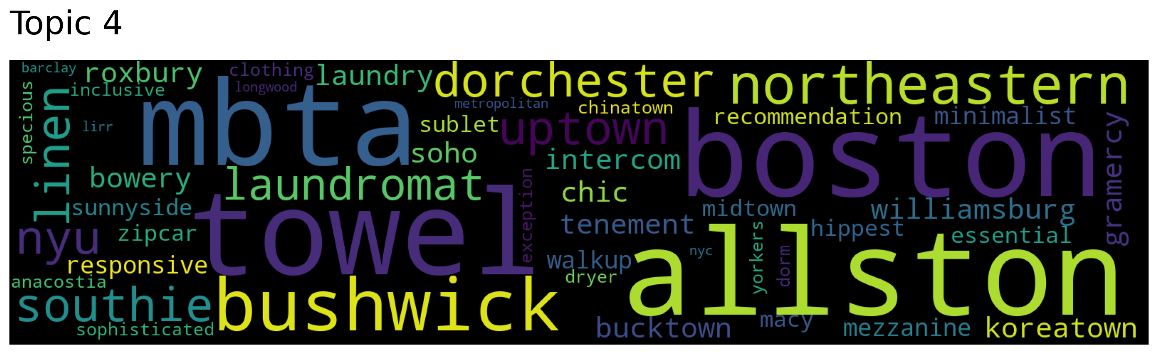
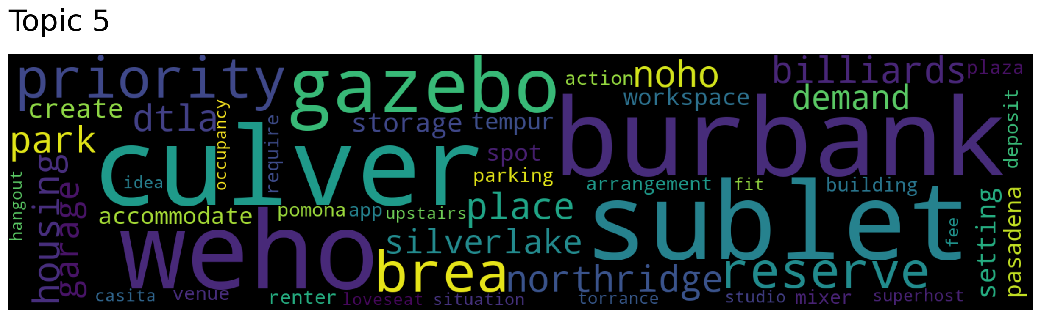
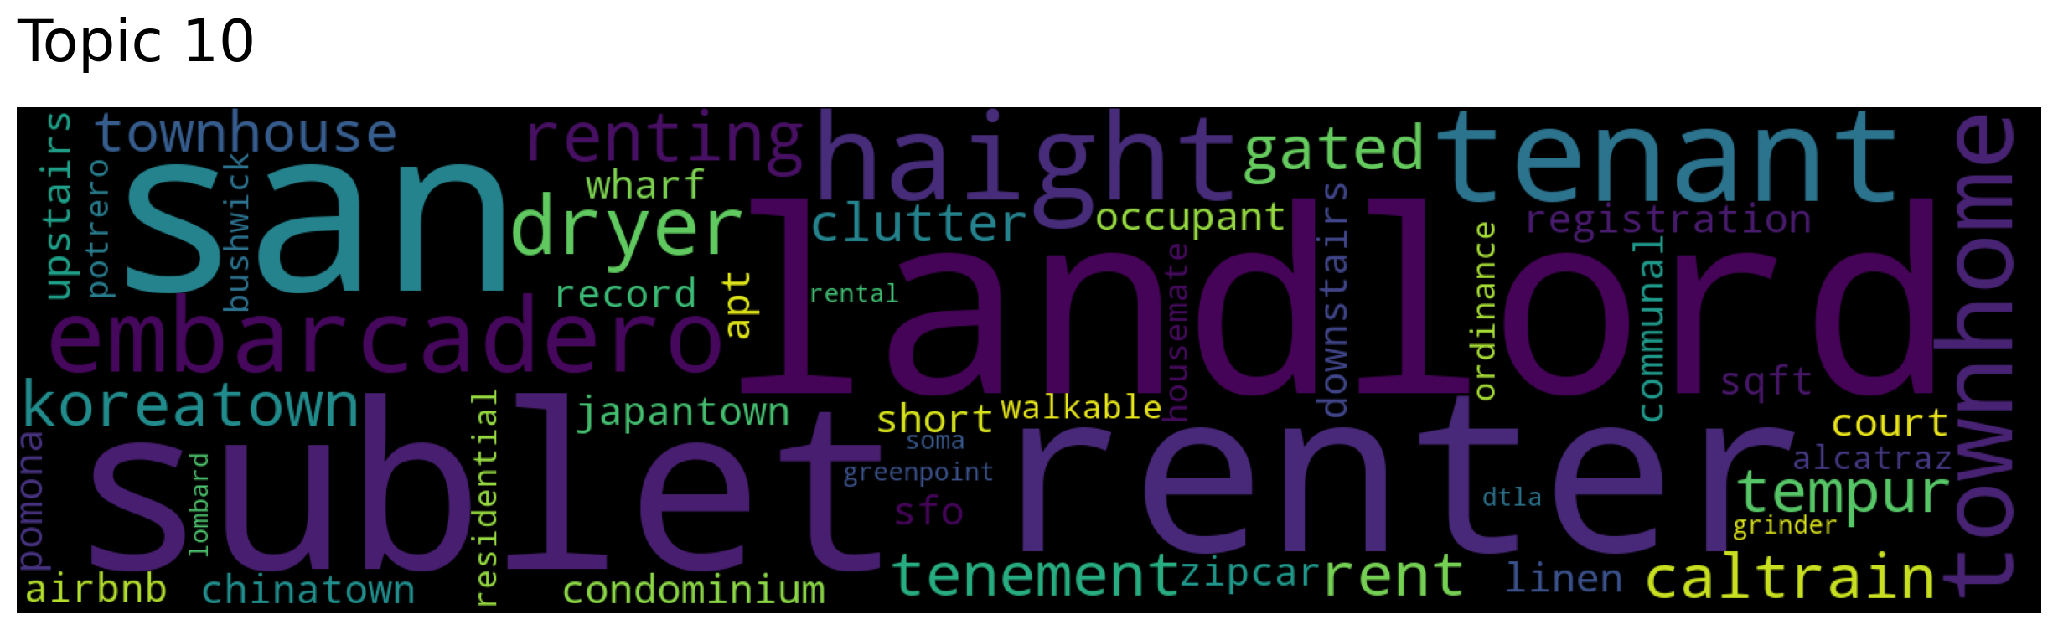
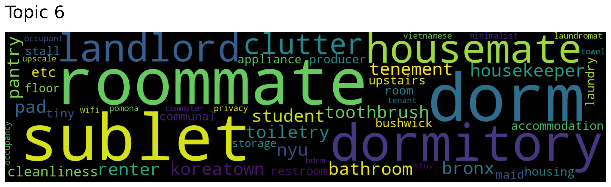
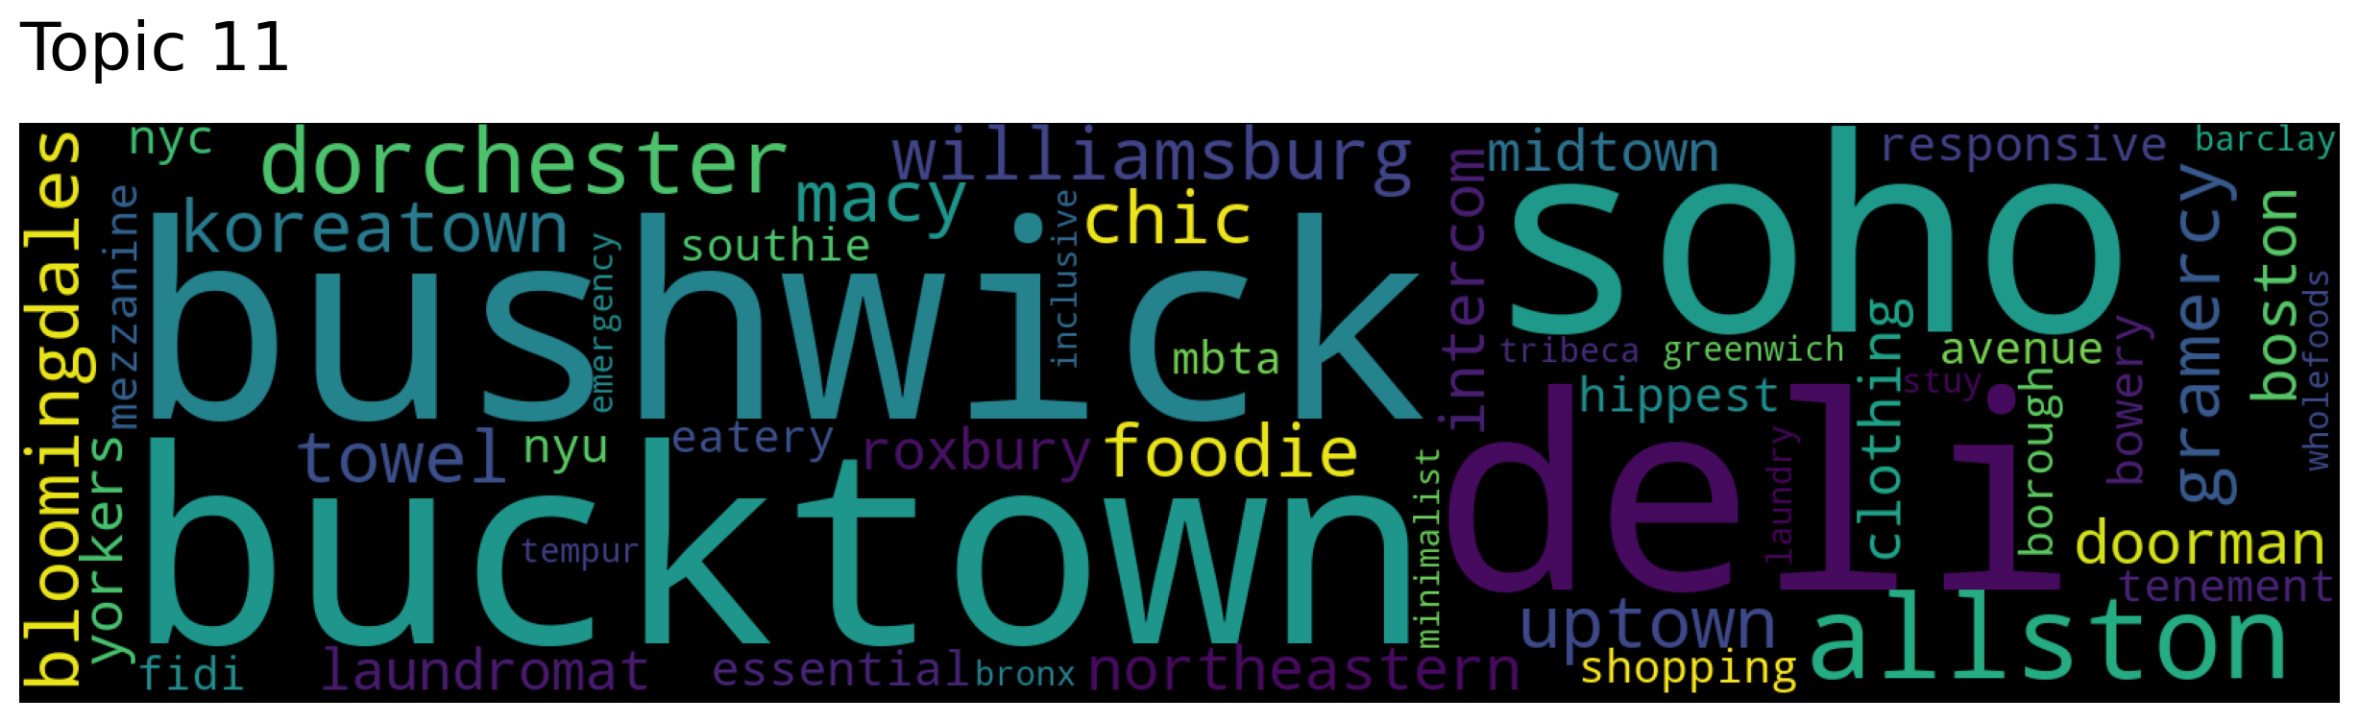
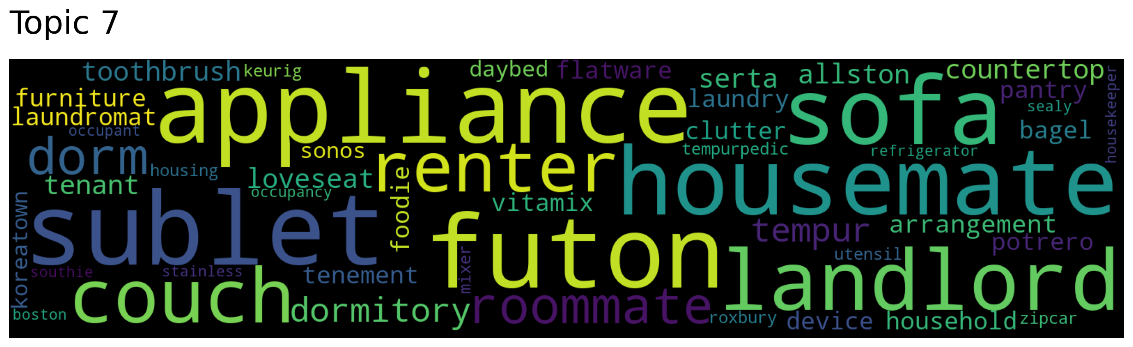
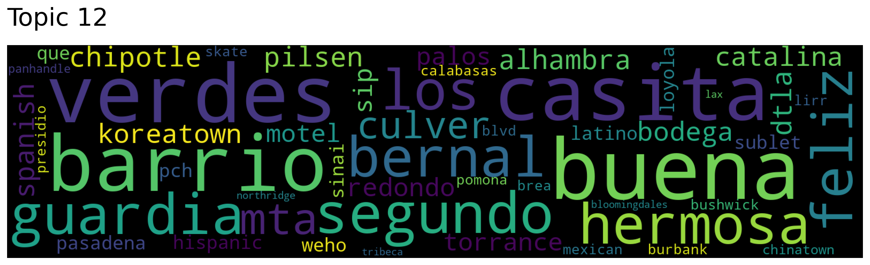
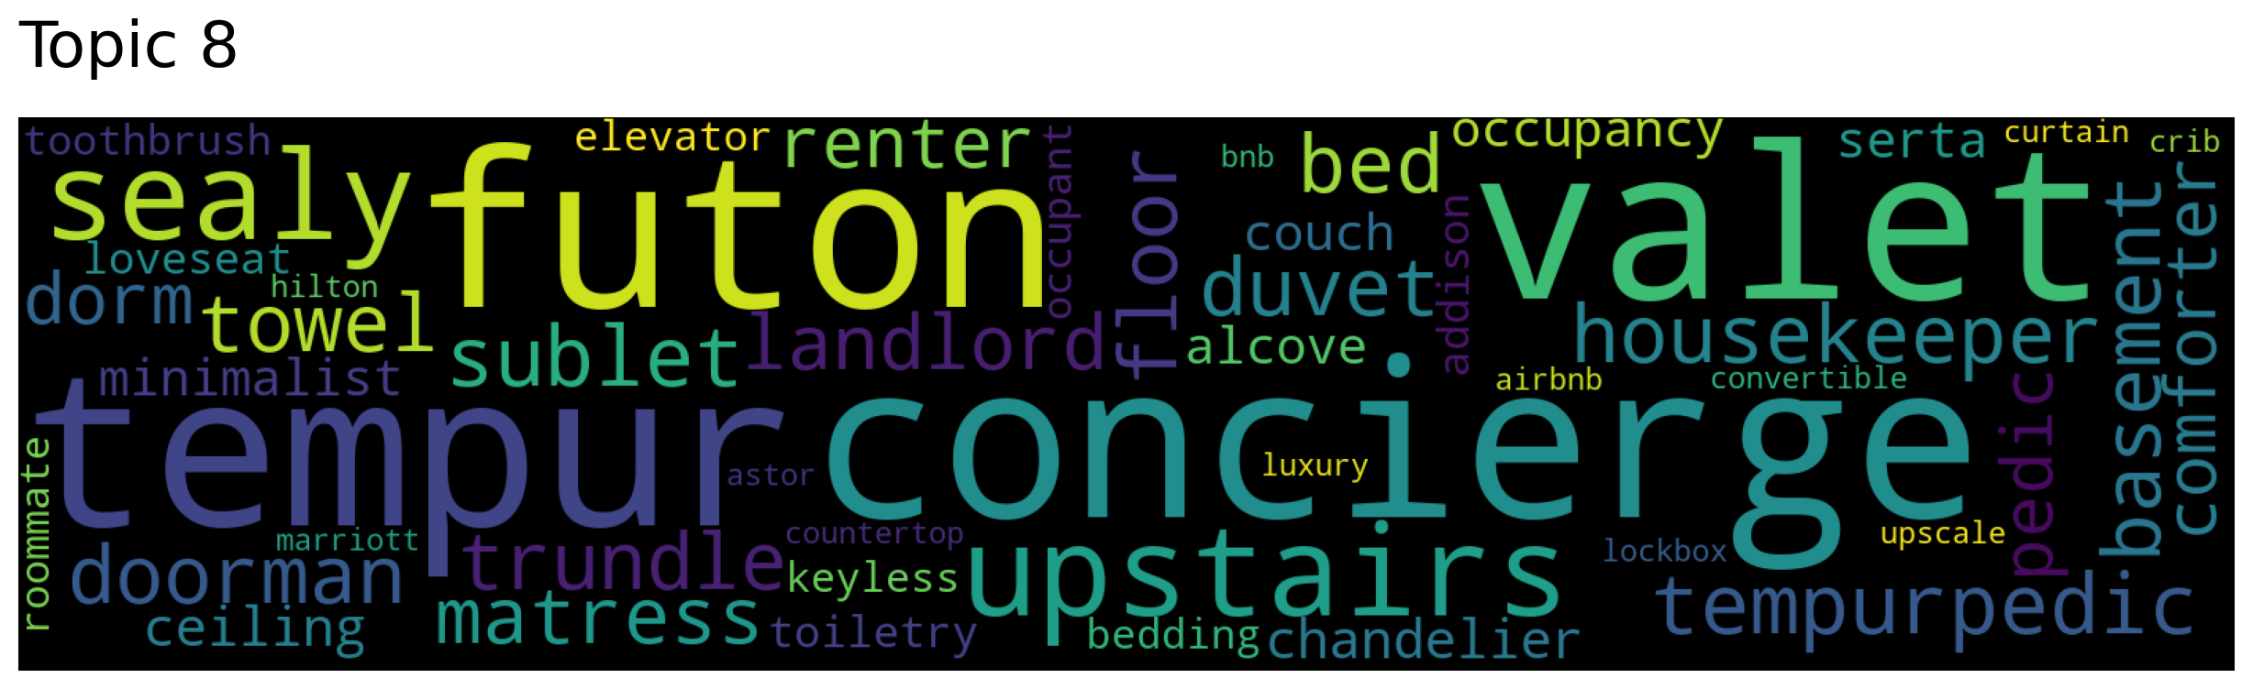
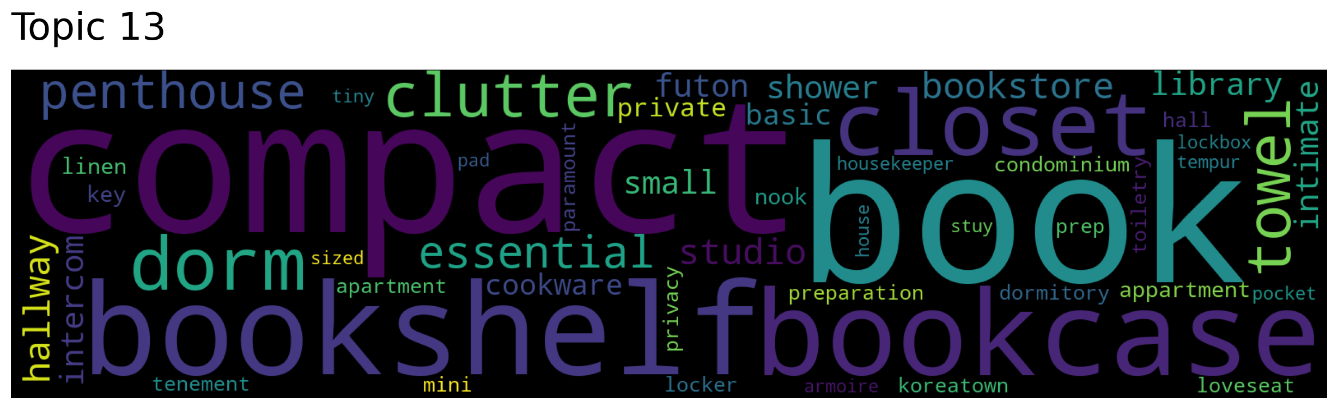
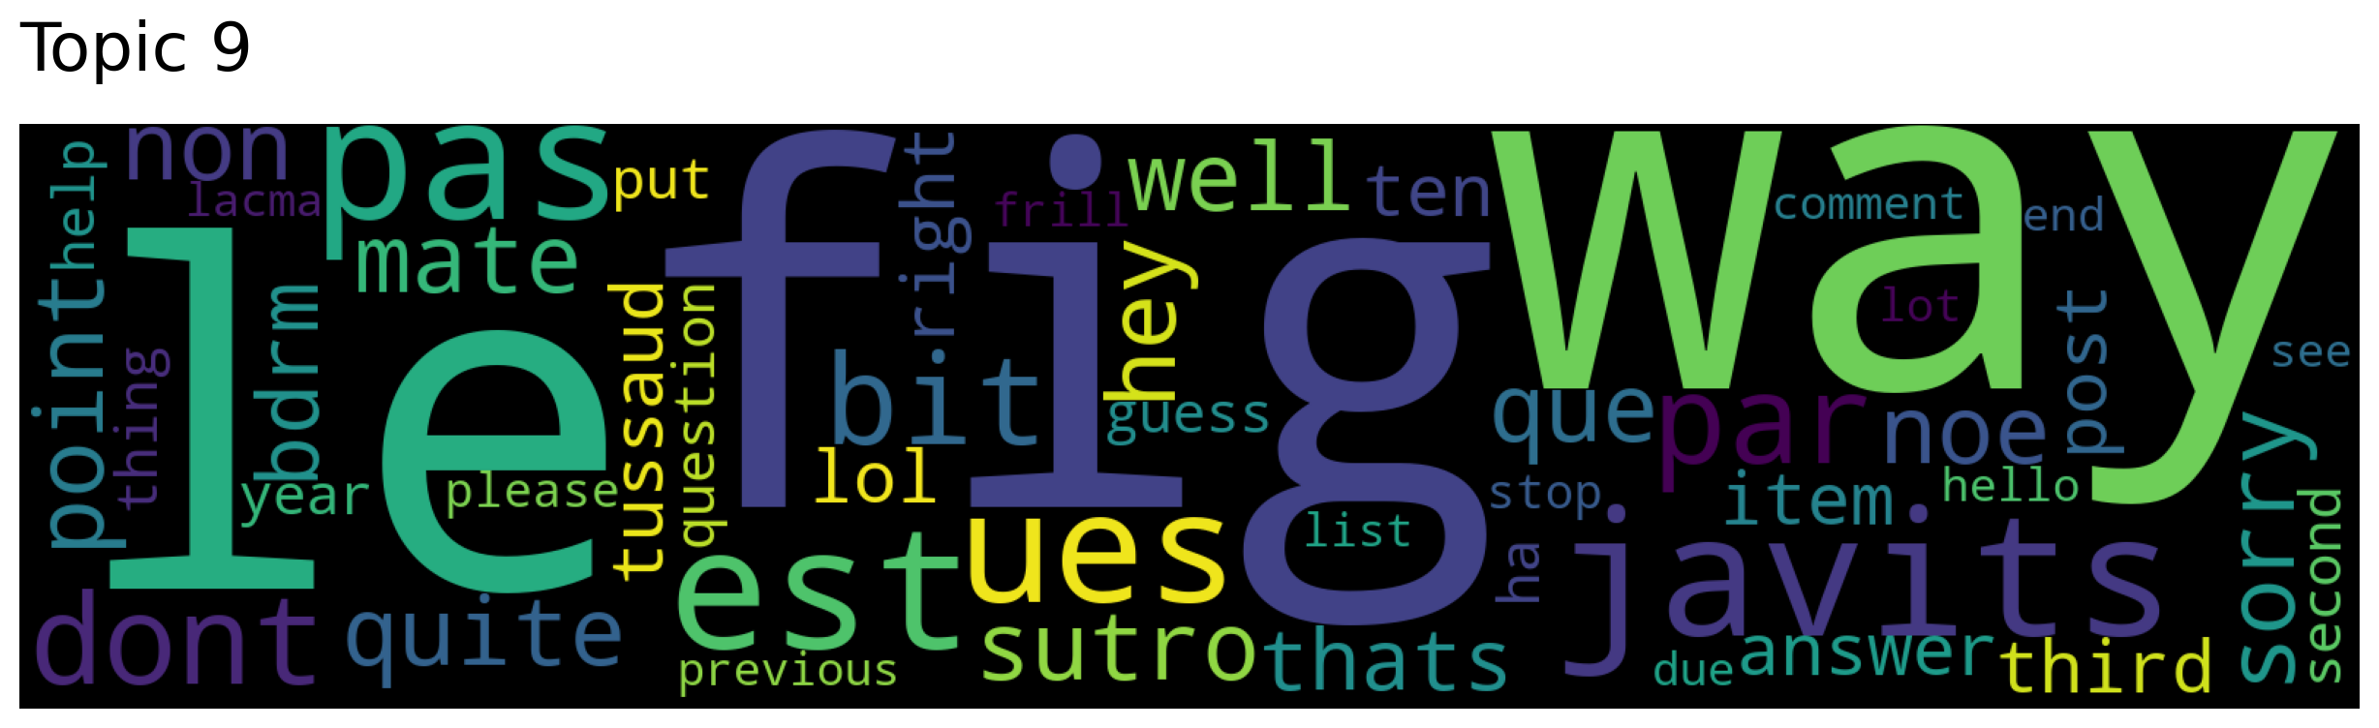
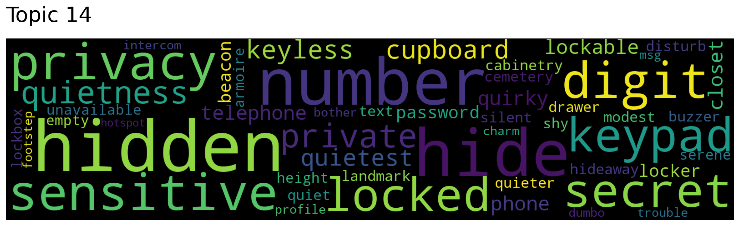
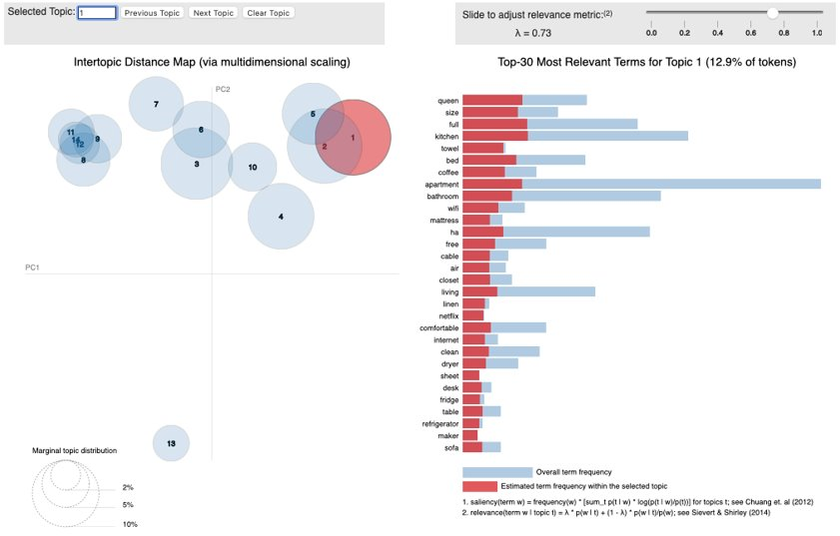
Topic Mining
Business Overview
Data Overview
Data Preparation
Model and Result
Key Findings
Challenges and Next Steps
Top2Vec
Leverages joint document and word semantic embedding
Latent Dirichlet Allocation(LDA)
Statistically calculated distance between documents. Viewed documents as bag of words (BoW)
selecting n topics
picking a set of words to this topic
TF-IDF + Truncated SVD + KMeans
Frequency-inverse document frequency
Sparse matrix
Elbow method + KMeans

Slide 21
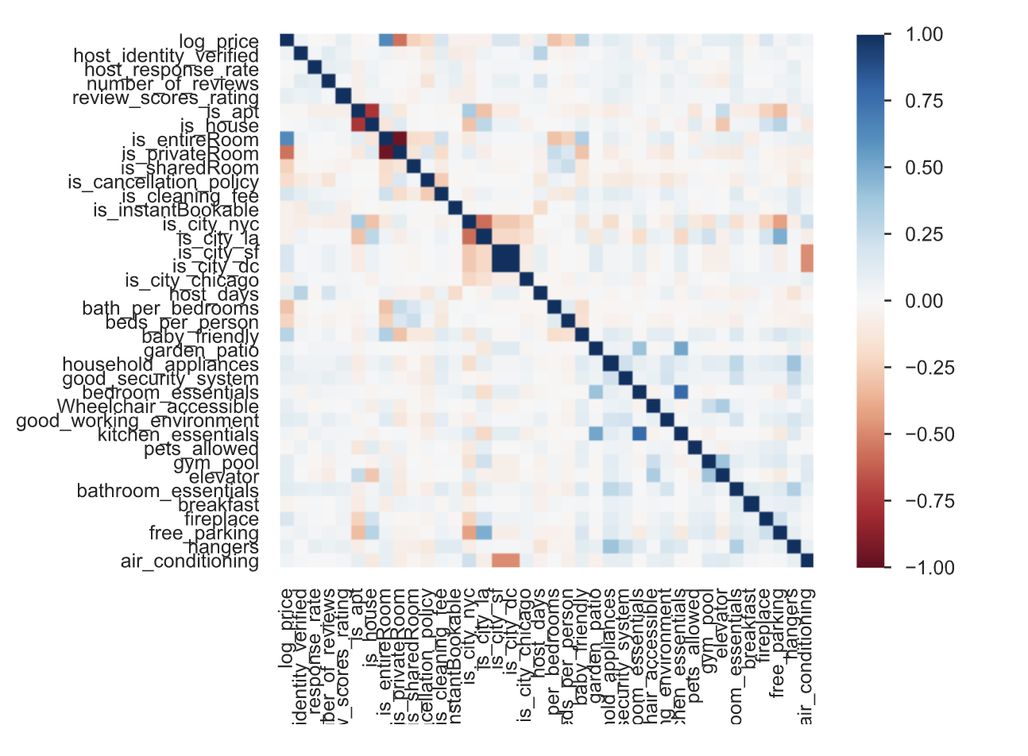
Business Overview
Data Overview
Data Preparation
Model and Result
Key Findings
Challenges and Next Steps
Correlation Heatmap

Slide 22
Models and Results
Model Interpretation
Results explanation

Slide 23
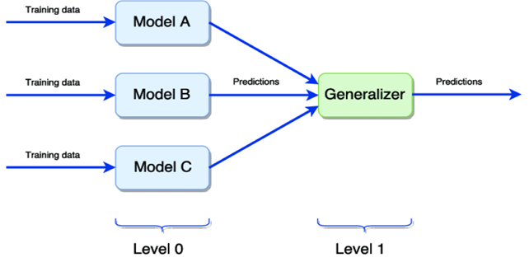



Regression Models
Business Overview
Data Overview
Data Preparation
Model and Result
Key Findings
Challenges and Next Steps
Linear Regression:
simple and fast, but complicate to optimize
Random Forest:
Easy data preparation, white-box, strong predicting power, but time consuming.
Gradient Boosting:
Strong predicting power, time-consuming as well.
STACKING REGRESSOR
Combine models together
Notes:
Linear Regression: Ordinary least squares Linear Regression.
Random Forest
Gradient Boosting: Gradient boosting, just like any other ensemble machine learning procedure, sequentially adds predictors to the ensemble and follows the sequence in correcting preceding predictors to arrive at an accurate predictor at the end of the procedure.
Voting Regressor
Stacking Regressor :Stack of estimators with a final regressor.

Slide 24
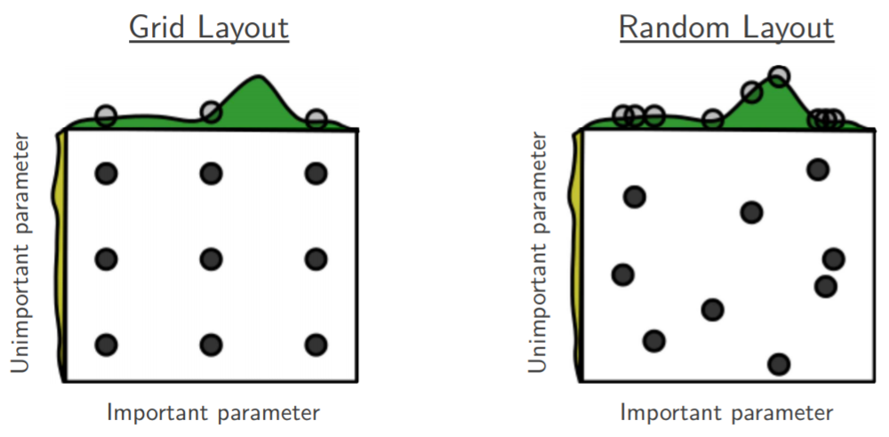
Hyperparameter Tuning
Business Overview
Data Overview
Data Preparation
Model and Result
Key Findings
Challenges and Next Steps
Random CV Search
Grid CV Search
vs
Notes:
sklearn.model_selection.GridSearchCV: Exhaustive search over specified parameter values for an estimator. The grid search provided by GridSearchCV exhaustively generates candidates from a grid of parameter values specified with the param_grid parameter.
RandomizedSearchCV implements a randomized search over parameters, where each setting is sampled from a distribution over possible parameter values.

Slide 25
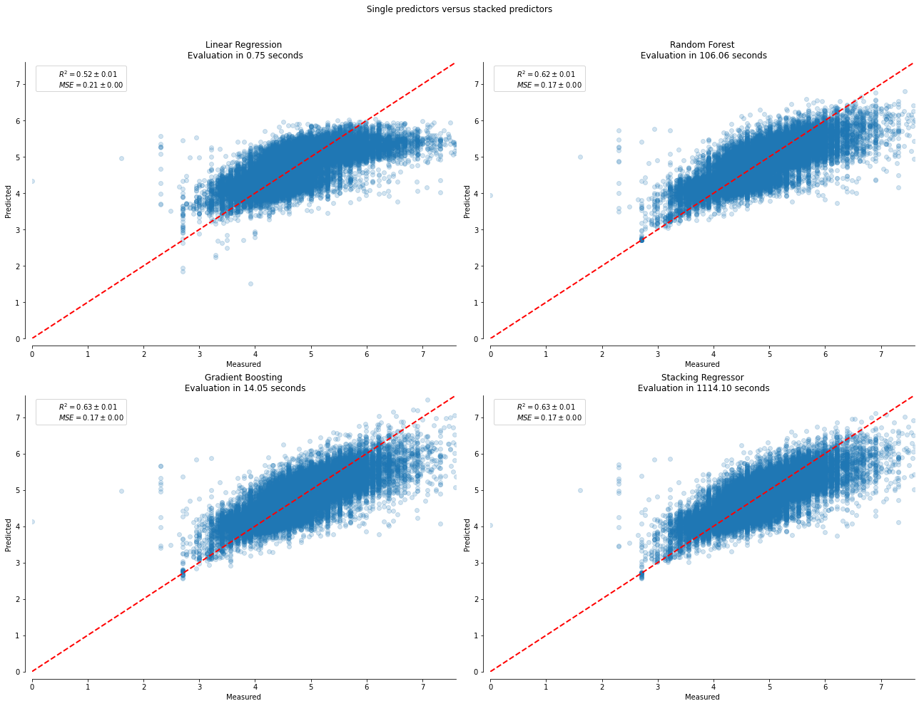
Model Performance Comparisons
Business Overview
Data Overview
Data Preparation
Model and Result
Key Findings
Challenges and Next Steps
Linear Regression
Random Forest
R^2=0.52
MSE = 0.21
R^2=0.62
MSE = 0.17
Gradient Boosting
Stacking Regressor
R^2=0.63
MSE = 0.17
R^2=0.63
MSE = 0.17

Slide 26
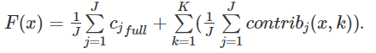
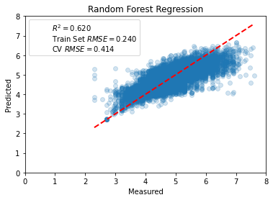
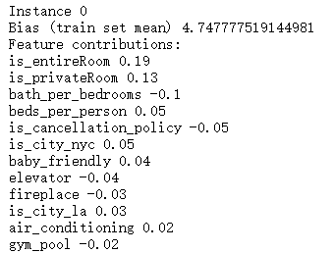
Model Interpretation
Business Overview
Data Overview
Data Preparation
Model and Result
Key Findings
Challenges and Next Steps
...
Notes:
Random forest as white box.

Slide 27
Key Findings
Feature Importance
Key Findings

Slide 28
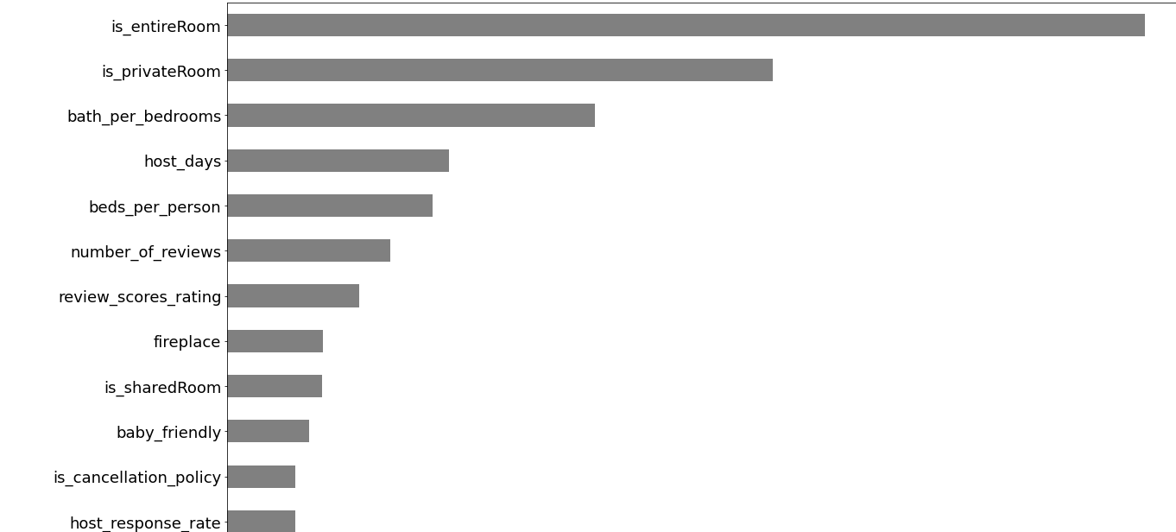
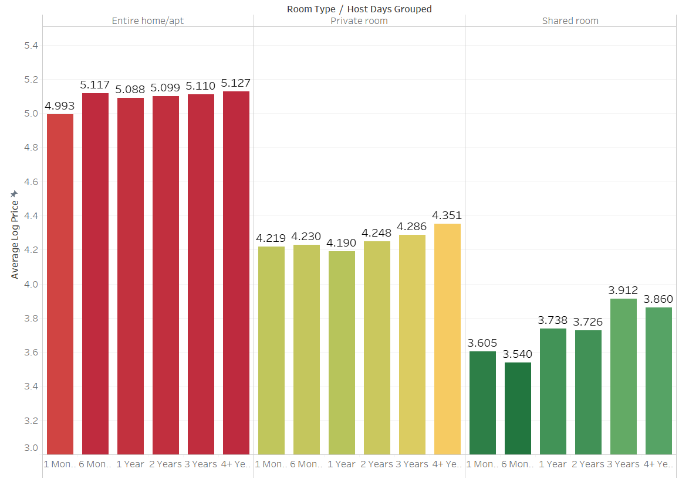
Feature Importance
Business Overview
Data Overview
Data Preparation
Model and Result
Key Findings
Challenges and Next Steps
...
Notes:
Here are the most important features after we run the random forest regression. And we group the related variables with color.
We see that the room type is very important and the importance level is also reflected through their impact on price and this also applies to host days.
The two amenities that are important is fireplace and baby friendly. This could be further explored
The two variables that we created in the feature engineering procedure bath per bedroom and bed per person are important which means our feature engineering works.

Slide 29
Key Findings
Business Overview
Data Overview
Data Preparation
Model and Result
Key Findings
Challenges and Next Steps
EDA
Experienced hosts will charge higher
Great fluctuation within our dependent variable
Vague clustering after TSNE
Model
Room type, Accommodates, Beds have significant influence on price
Amenities don't always have positive impact on price
Price difference exists city-wise
Notes:
EDA finding:
EDA alone, we see experienced hosts charger more expensive and log price above 5.0, review score ratings have significant fluctuations
Even after perplexity tuning, we did not observe clear boundaries between clusters for TSNE
Model Finding

Slide 30
Challenges and Next Steps
Study Limitations
Future Improvements

Slide 31

Study Limitations and Future Improvements
Business Overview
Data Overview
Data Preparation
Model and Result
Key Findings
Challenges and Next Steps
The scale of our data is still limited
The text mining did not contribute much
Overfitting of model
Generate new variables
Try other algorithms
Refine our variables
Retrieve more data
Do sentiment analysis on description
Try deep learning algorithms
Notes:
#1 Limitation
The scale of our data is limited due to the scope of our dataset. We can tackle this by either generate new analytical variables such as # of airbnbs within radius of the current listing from our existing data by incorporating other techniques such as GIS or dive deeper into neighborhoods. Or we can do analysis on the thumbnails of the property and analyze as a result. Or we can try to retrieve new data by scraping or incorporate other datasets with similar features.
#2 Limitation
Right now, while we did topic mining for description and saw some detailed top2vec word clouds that are related, and we did truncated SVD for the topics, but they did not contribute much to our model even when we put them into our model when se select the topics selected by Kmeans. So what we can do is we can do a sentiment analysis of the descriptions and use sentiments instead of topics and apply them to our model, we could also try other algorithms as well.
#3 limitation
We have applied four algorithms to our model, Linear Regression, Random Forest, Stack Regressor, Gradient Booster and our gradient booster and random forest turns out to have good results. Our model suffers overfitting, so what we may need to do is to go back to feature engineering after the model and refine our variable. Another thing we can do is to try the deep learning algorithms like CNN.

Slide 32




Price Adjustment System
Smart
Pricing
System
Price Adjustment System
Notes:
At last, we want to proposed two solutions based on our model result. The first one is the price adjustment system. For frequent Airbnb users, they can now start to purchase premium subscription to received price compensation when the property in one area is overprice according to the system output. This will help frequent traveler mitigate the risk of overpaying. However, the compensation will not exceed the 10% that Airbnb charged. The second recommendation is the smart pricing system: this system severed as a guide line for household to charge at a fair price. This is especially useful for new users when they list their property for the very first time. Another use case for the system is when a property has a hard time to find its user, the system will notify the owner with a fair price if they want to generate cashflow. And that’s is for all our presentation. Thank you all for listening.

Slide 33


THANK YOU

Slide 34

Appendix

Slide 35
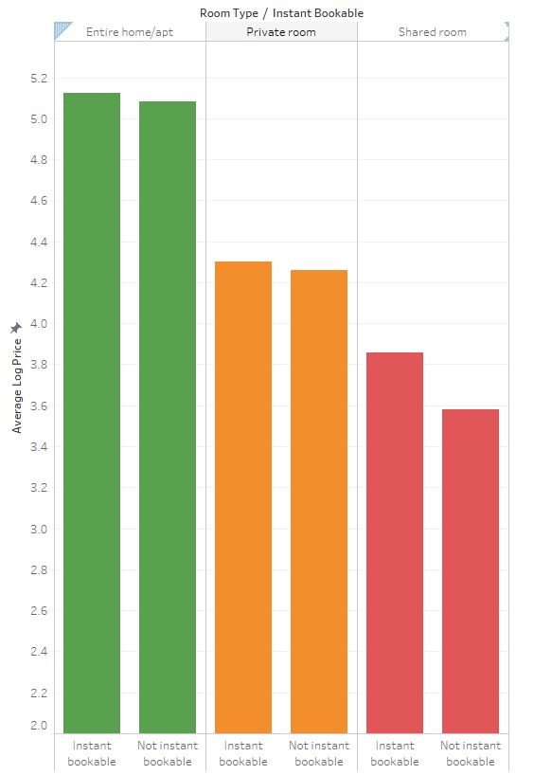
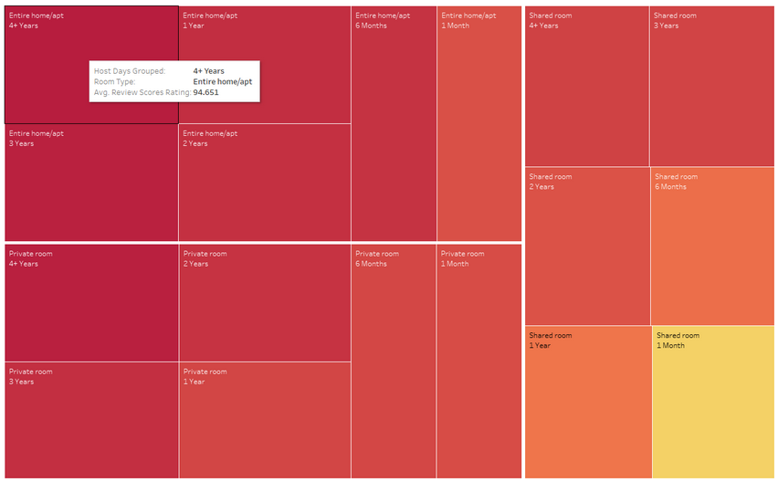
Appendix: data visualizations

Slide 36
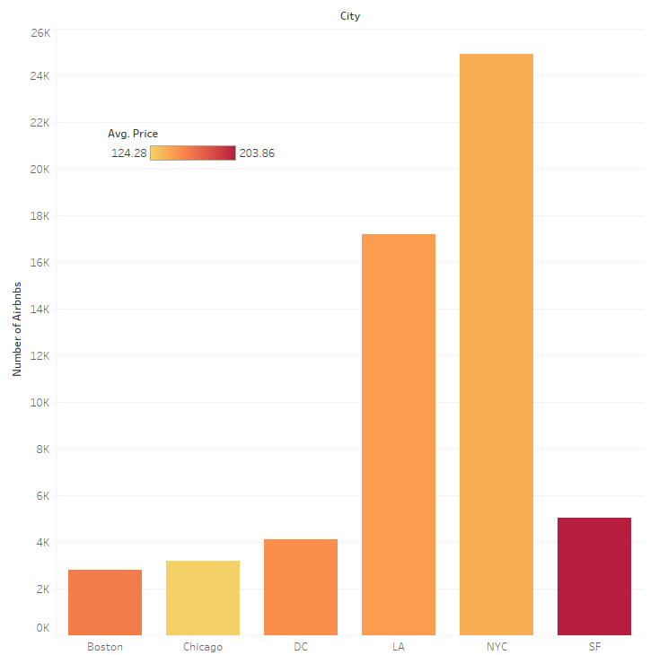
Appendix: data visualizations
Number of Airbnbs by City

